Slide 1
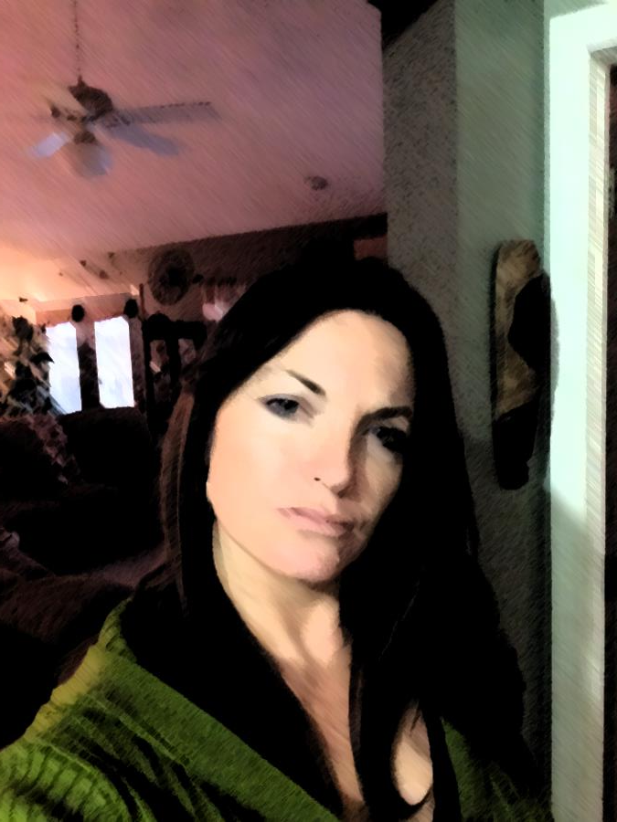
About Mrs. Bristol

Slide 2
All about Mrs. Bristol
Tiny Bristol | Fun Facts | Family Fun
EASY | Easy | Easy
Thinking Caps | Thinking Caps | Thinking Caps
Deep Thought | Deep Thought | Deep Thought

Slide 3
In what month was Mrs. Bristol Born in?
Tiny Bristol – Easy question
Answer

Slide 4

Tiny Bristol
Easy answer
September 1978 – shss. I’m not that old!

Slide 5
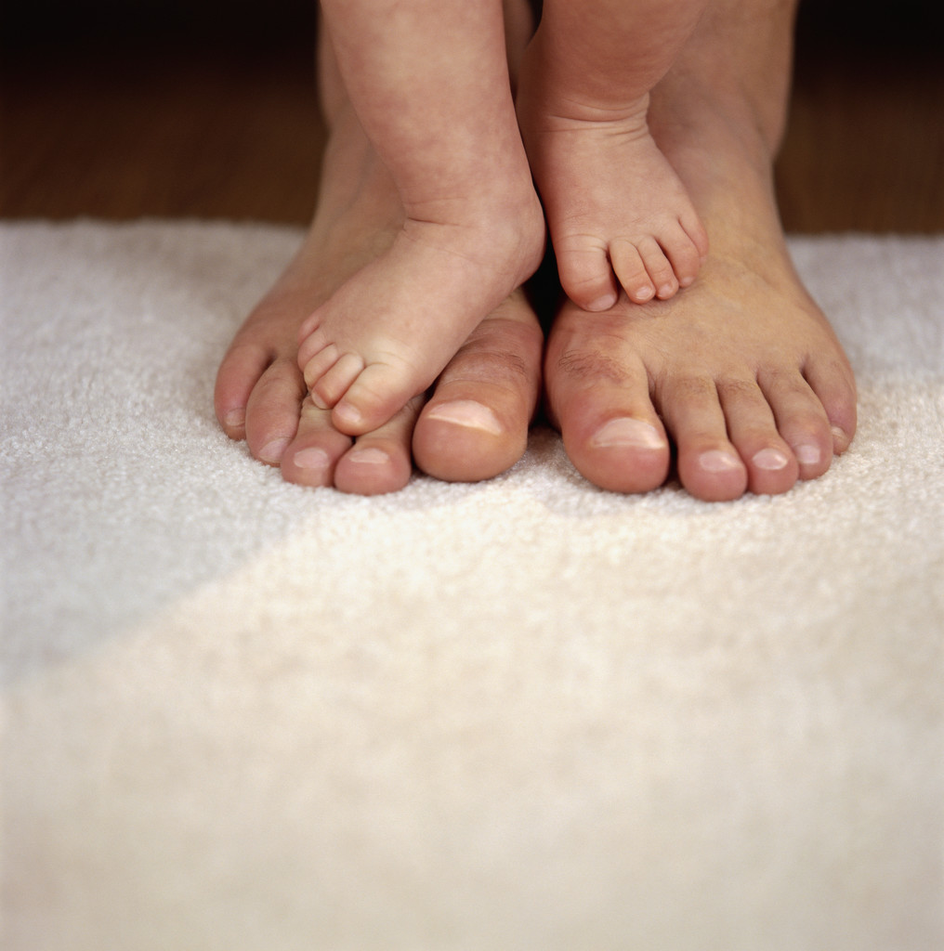
How many children does Mrs. Bristol have?
Answer

Slide 6
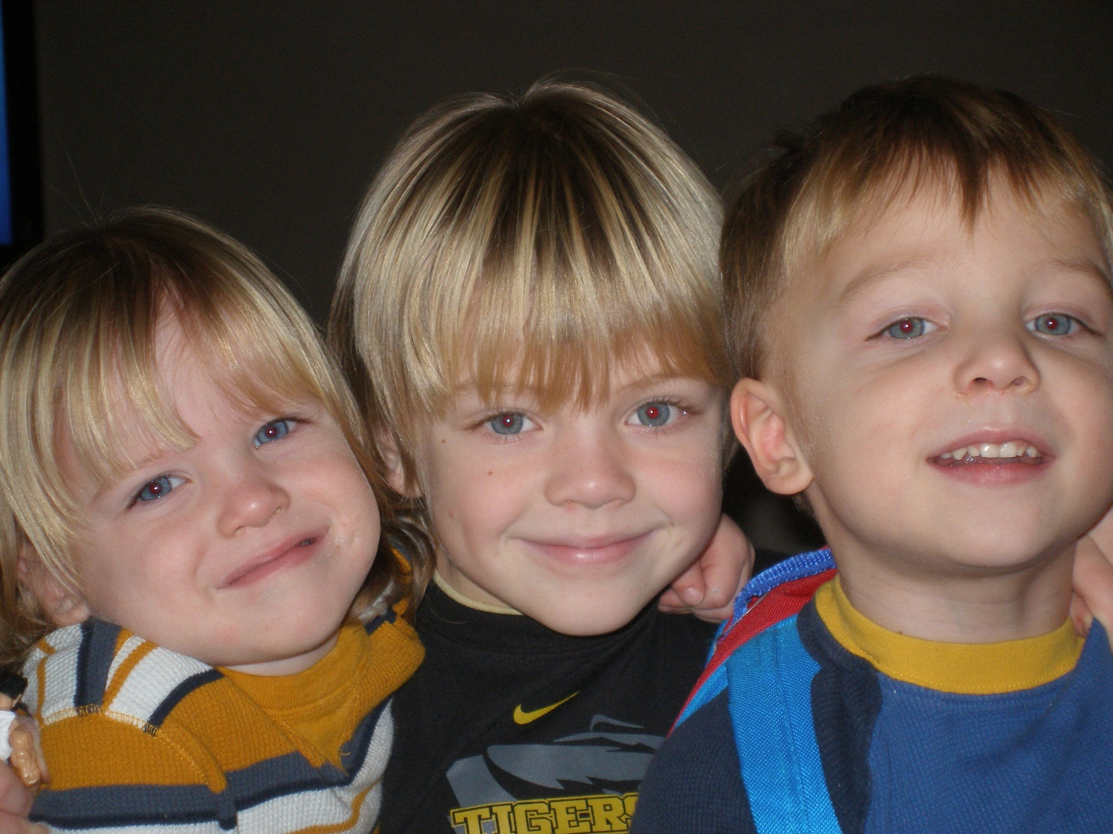
Yes, 3!

Slide 7
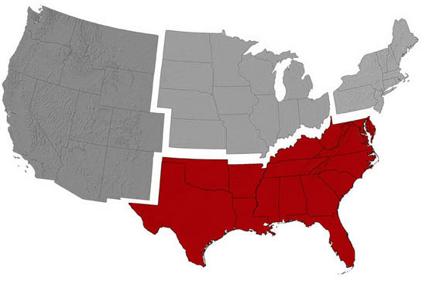
Where is my family from?
Answer

Slide 8
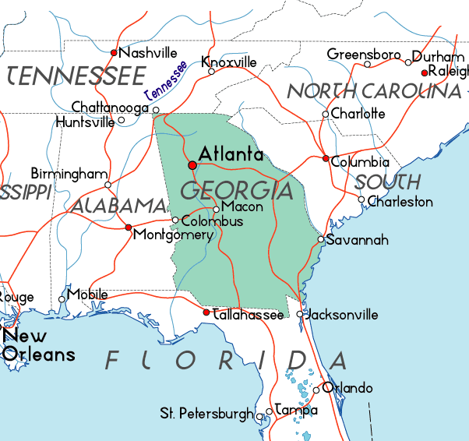
Georgia!

Slide 9
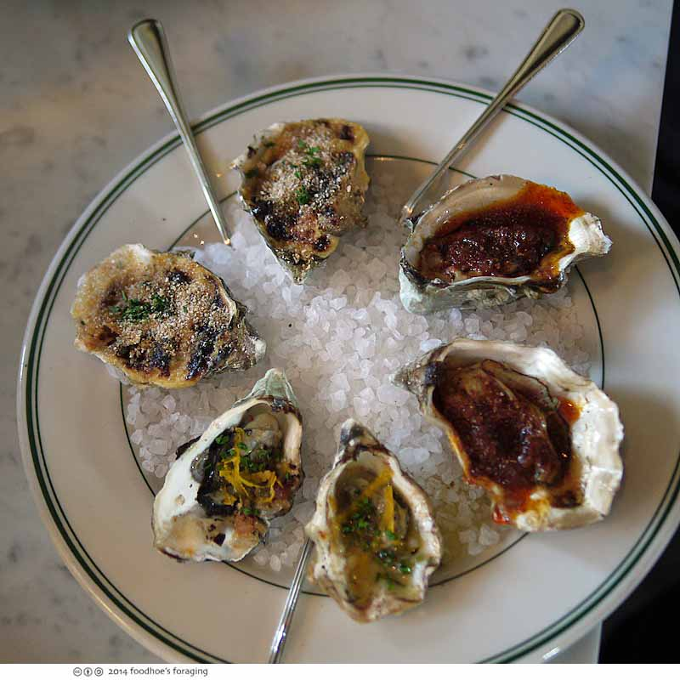
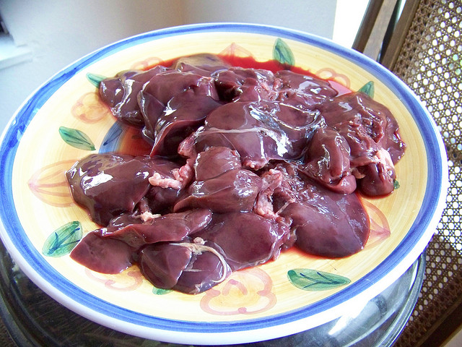
What do I like to eat that grosses people out?
Answer

Slide 10

YUCK
Liver and Oysters
  My dad paid me $100 to eat my first oyster when I was 10!

